Slide 1
Argo CD on EKS
GitOps continuous delivery tool for Kubernetes

Slide 2
Agenda
Argo CD Capability on EKS
The Business Challenge
Business Goals
Workshop Journey

Slide 3
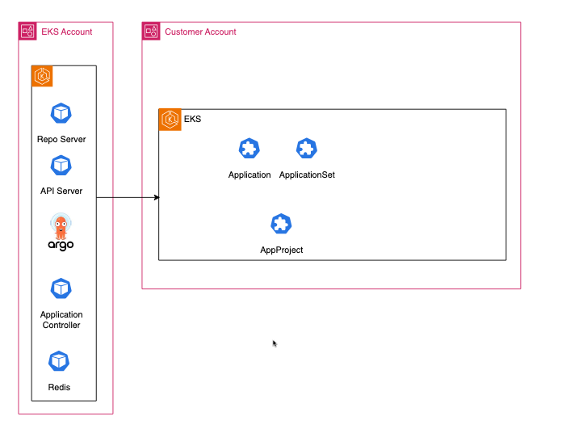
Argo CD Capability
Argo CD Full Managed by AWS
Install configure, configure and maintain Argo CD infrastructure
AWS Handles Operations
Automatic scaling, patching and operational management
Direct Integration with Identity Center
Seamless SSO and user management
Notes:
Let's start with what makes this different from traditional ArgoCD deployments. AWS has introduced a fully managed ArgoCD capability that fundamentally changes how we approach GitOps."
Point 1: Fully Managed by AWS (60 seconds)
"First, this is truly fully managed. Unlike self-hosted ArgoCD where you need to install, configure, and maintain the entire stack - the API server, repository server, application controller, Redis - AWS handles all of this for you. You simply enable the capability on your EKS cluster with a single Terraform resource or CLI command."
Point 2: AWS Handles Operations (45 seconds)
"AWS takes care of all the operational overhead. This means automatic scaling, security patching, high availability across multiple zones, and monitoring of the ArgoCD components."
Point 3: Identity Center Integration (45 seconds)
"What's particularly powerful is the native integration with AWS Identity Center. You can configure Identity Center with external Identity Provider like Okta, Ping, Active Directory etc. Your existing SSO setup, user groups, and permissions automatically work with ArgoCD.
Point 4: Focus on Applications (30 seconds)
"This shift means your platform teams can focus on what matters - building self-service capabilities for developers and delivering business value, rather than troubleshooting ArgoCD infrastructure"

Slide 4
Business Challenge: Eliminate Developer Friction
Developers are blocked , waiting for
Provision new environments
Deploy applications to production
Configure access permissions
Troubleshoot deployment issues
Notes:
One of the most common pain points we hear from customers is developer friction. Developers are blocked, waiting for another team to handle requests.
For example
Environment Provisioning: First, provisioning new environments. A developer needs a staging environment to test their feature. They submit a ticket, wait 2-3 days for approval and provisioning. Meanwhile, they're either blocked or working on something else, losing context on their original task. Production Deployments: "Then there's production deployments. Even with CI/CD pipelines, the final deployment often requires another team involvement. Developers submit deployment requests, wait for maintenance windows, and if something goes wrong, they're dependent on the another team to troubleshoot.
The Business Impact "The result? Platform teams are overwhelmed with tickets, developers are frustrated and unproductive, and your time-to-market suffers.

Slide 5
Business Goals
Reduce Developer Friction
Accelerate Time-to-Market
Improve Developer Experience
Scale Platform Operations
Enhance Security & Compliance
Reduce Operational Overhead
Notes:
So how do we solve business challenges? Reduce Developer Friction: Enable self-service capabilities so developers can deploy without waiting for platform team tickets
Accelerate Time-to-Market: Faster feature delivery through automated workflows that eliminate manual bottlenecks
Improve Developer Experience: Consistent, reliable deployment processes across all environments
Scale Platform Operations: Platform teams focus on building capabilities and automation, not handling repetitive tickets
Enhance Security & Compliance: Automated governance guardrails without sacrificing development speed
Reduce Operational Overhead: Minimize manual processes and human error through GitOps automation

Slide 6
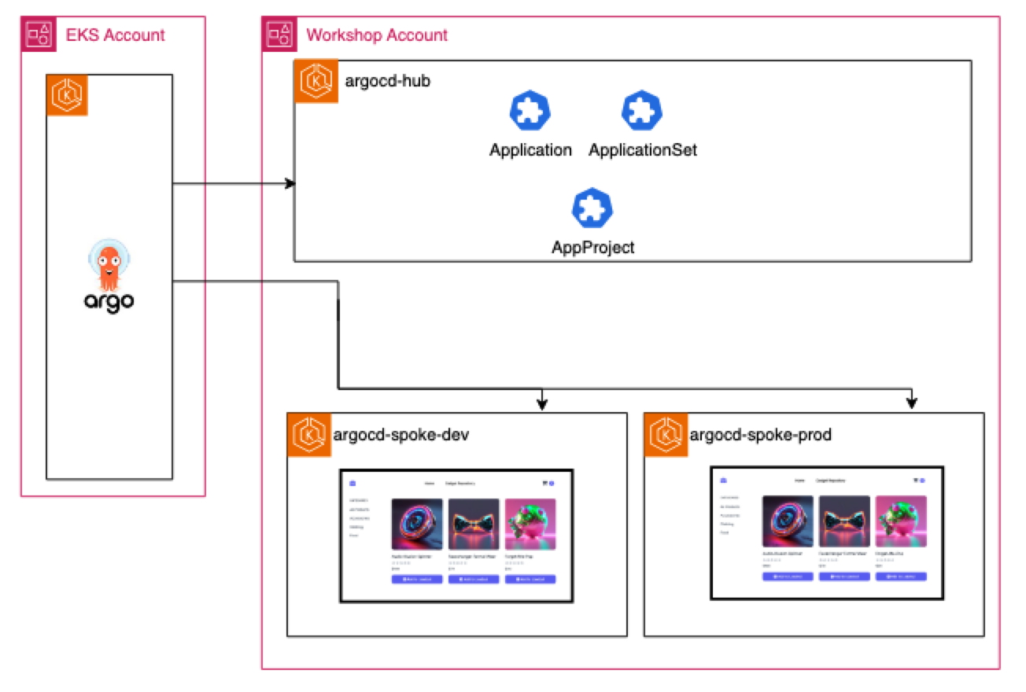
Tech Design: Centralized Control with Hub-Spoke
• Hub Cluster
• Spoke Clusters
• Cross-Cluster Connectivity
• Centralized Management
Notes:
Hub Cluster: Where you create and manage ArgoCD resources - Applications, ApplicationSets, and Projects. The actual ArgoCD control plane is managed by AWS, but your hub cluster is where you define what gets deployed.
Spoke Clusters: Your target environments - development, staging, production. These clusters are registered with ArgoCD and receive deployments from the hub.
Cross-Cluster Connectivity: AWS-managed ArgoCD service securely deploys to your spoke clusters without complex networking setup.
Centralized Management: Single hub cluster to define all your GitOps configurations. AWS-managed ArgoCD reads these configurations and orchestrates deployments across all registered spoke clusters.

Slide 7
Tech Design: Self Service Through Automation
Cluster Registration: New environments automatically register via Git commits
Team Onboarding: Developers provide team info in git and get their own namespace, project, and deployment pipeline
Application Deployment: Developers deploy through Git
Notes:
Cluster Registration: When platform teams create new environments, they simply commit cluster configuration files to Git. ArgoCD ApplicationSets automatically detect these new cluster definitions and register them with the GitOps system.
Team Onboarding: New development teams create a their team information in git - team name, members, and basic requirements.. The system automatically provisions their dedicated namespace, creates an ArgoCD project with appropriate RBAC permissions, and sets up their deployment pipeline. Everything they need to start deploying applications.
Application Deployment: Developers work entirely through Git workflows. They commit their application manifests or Helm charts to their repository, and ArgoCD automatically detects changes and deploys to the appropriate environments.

Slide 8
Tech Design: Multi-Tenancy
ArgoCD Projects: Automatic team isolation and resource boundaries
RBAC Integration: AWS SSO provides role-based access (Team Lead, Developer, DevOps)
Namespace Isolation: Each team gets their own secure workspace
Notes:
ArgoCD Projects: Each team automatically gets their own ArgoCD Projects that acts as a security boundary. The project defines exactly which Git repositories they can deploy from, which clusters and namespaces they can target, and what types of Kubernetes resources they're allowed to create. This prevents teams from accidentally or intentionally deploying to other teams' environments or accessing resources outside their scope.
RBAC Integration: Your existing AWS SSO groups seamlessly map to ArgoCD permissions. Team Leads get full project management rights - they can modify project settings and manage team member access. Developers get deployment permissions within their project boundaries. DevOps engineers get cross-project visibility for troubleshooting and platform management. No separate user management system to maintain - it all flows from your existing identity provider.
Namespace Isolation: Each team receives dedicated Kubernetes namespaces across all environments - dev, staging, production. These namespaces come with pre-configured resource quotas to prevent resource exhaustion, and RBAC policies that ensure team members can only access their own resources. Teams can't see or interfere with other teams' workloads, creating true multi-tenancy within shared clusters.
This creates a secure, self-service environment where teams have freedom to operate within well-defined boundaries, eliminating the need for platform teams to manually manage access controls.

Slide 9
Tech Design: Security & Governance Guardrails
ECR-Only Deployments
Default Project Lockdown
Resource Governance
Network Policies
Source Control
Destination Control
Group-Based Access
Notes:
ECR-Only Deployments: All container images and Helm charts must come from your organization's ECR registry. This prevents supply chain attacks and ensures all artifacts go through your security scanning and approval process. ArgoCD Projects enforce this at the platform level, so developers can't bypass it by referencing external registries.
Default Project Lockdown: The default ArgoCD project is completely restricted - no deployments allowed. This prevents unauthorized or accidental deployments outside of approved team projects. Every deployment must go through a properly configured team project with defined boundaries and approvals.
Resource Governance: Automatic resource quotas and limits are applied to every namespace. Teams can't consume unlimited CPU, memory, or storage, preventing resource exhaustion that could impact other teams.
Network Policies: Micro-segmentation between namespaces and services is automatically configured. Teams can only communicate with their own services and explicit
tly approved external services. This prevents lateral movement in case of security breaches and ensures compliance with zero-trust networking principles.
Source Control: ArgoCD Projects restrict which Git repositories teams can deploy from. Teams can only deploy from their approved repositories, preventing deployment of unauthorized code or access to other teams' source code.
Destination Control: Teams can only deploy to their designated namespaces and clusters. A development team can't accidentally deploy to production, and teams can't deploy to other teams' environments, even if they have access to the manifests.
Group-Based Access: All permissions flow from AWS SSO group membership. Add someone to the "TeamA-Developers" group, and they automatically get appropriate ArgoCD permissions. Remove them from the group, and access is immediately revoked. No manual ArgoCD user management required.

Slide 10
Workshop Journey
Prerequisites: GitOps principles, Argo CD Capabilities
• Argo CD Fundamentals: Applications, ApplicationSets, Projects
• Setup Automation: Cluster registration and Team onboarding
• Onboard Clusters: Dev & Prod environments
• Onboard Teams: Deploy to Dev & Prod environments
Notes:
Prerequisites: We'll start by reviewing GitOps principles - the four core tenets of declarative, versioned, pulled, and reconciled. Then we'll dive into AWS's managed ArgoCD capability and how it differs from self-hosted ArgoCD. This foundation is crucial for understanding why our approach works.
ArgoCD Fundamentals: Next, we'll explore the three core ArgoCD resources you'll work with daily. Applications define what gets deployed where. ApplicationSets dynamically generate multiple Applications using generators - perfect for multi-environment deployments. Projects provide the governance layer, defining team boundaries and access controls.
Setup Automation: This is where we build the self-service magic. We'll create ApplicationSets that automatically register new clusters when platform teams commit cluster definitions to Git. Then we'll build team onboarding automation that provisions namespaces, projects, and RBAC when teams submit pull requests. No more manual setup processes.
Onboard Clusters: Now we'll act as platform teams, registering our development and production clusters through Git commits. You'll see how the automation we built immediately detects these new clusters and makes them available for deployments. This demonstrates the platform team experience.
Onboard Teams: Finally, we'll switch perspectives and act as development teams. We'll onboard a new team through a simple pull request, then deploy a 5-service retail application across both dev and prod environments. You'll experience the developer workflow - from team creation to production deployment, all through Git.

Slide 11
Your Name
YourAlias@amazon.com

